Slide 1
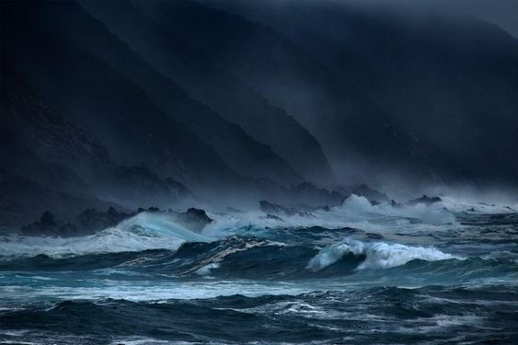
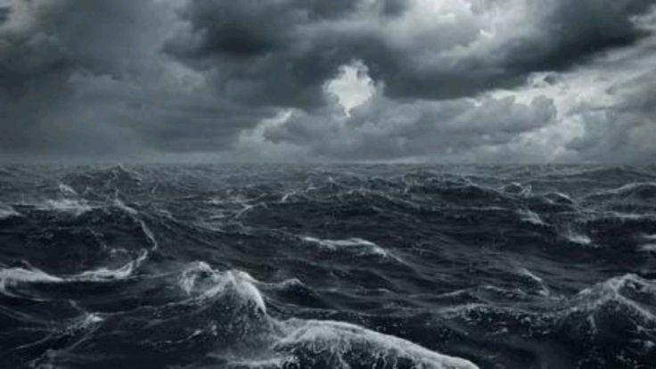
DM-GY 6063 2024F B Mid-Term Project
Shu Yang 2024/11/04

Slide 2
Moby Dick, or the Whale
The story is narrated by Ishmael, a sailor aboard the whaling ship Pequod, commanded by Captain Ahab. Ahab is consumed by his obsession with hunting down the massive white whale, Moby Dick, to exact revenge for the leg he lost on a previous voyage.
The novel also delves into themes like social class, the nature of good and evil, and religion. Ithe narrative vividly portrays life at sea while reflecting on life ashore. I admire its rich depiction of maritime life and respect Ahab’s relentless pursuit of his goal, even as it verges on madness.

Slide 3
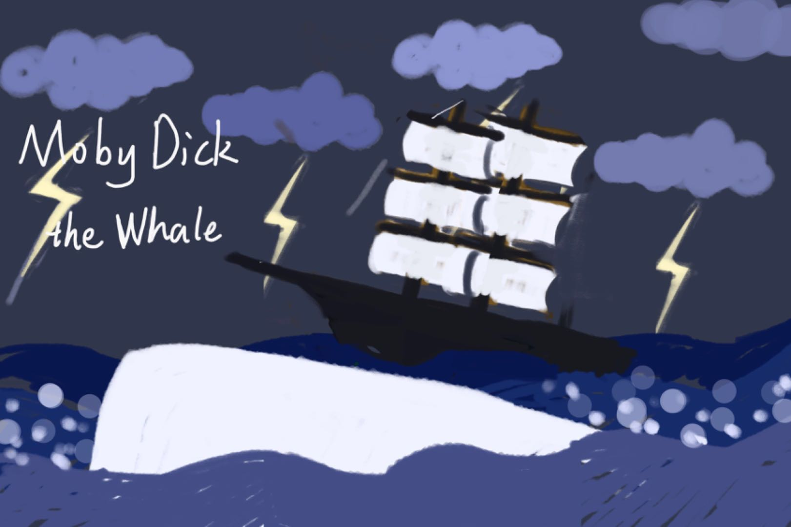
Moby Dick, or the Whale
In my cover, I explore the central plot of Moby Dick, which is the whaling ship’s pursuit of the elusive white whale, Moby Dick, with a background of turbulent waves and a stormy sky illuminated by flashing lightning.
After creating the initial draft, I break it down into several elements and utilize functions to individually achieve the visual effects I envisioned.

Slide 4
Moby Dick, or the Whale
Clouds: The clouds() function draws clouds based on given x, y positions, size, and number of ellipses per cloud. Each ellipses has a slightly animated effect using sine functions to simulate the movement of the real cloud.
Thunder: The thunder() function draws a white zigzag line over the cloud when the thunder state is true. This state is toggled in mousePressed(), causing thunder to appear briefly across all clouds and change the background color
Wave: The waterWave() function creates a wave pattern by using loop and sine to decide vertex positions, giving the impression of a rolling sea.
Ship: The ship() function creates a ship by using a combination of shapes. The hull can also move with wind. And I used sin() to let the ship gently rocks to simulate the natural motion of floating on water. This rotation will be intensified if the whale is nearby.

Slide 5
Moby Dick, or the Whale
Whale: The whale image follows the mouse’s horizontal position (mouseX), while its vertical position is mapped to the mouse’s y-position with limited range for smoother and reasonable movement. And it tilts also using sine fuction for a natural swimming effect.
Bubble Effect: The bubble() function generates bubbles near the whale’s position, using a changing opacity and random sizing for a realistic look.
Title Text: The text "Moby.Dick" is displayed at a static position, using an imported sans-serif bold font.

Slide 6
Challenges
I initially thought it would be challenging to make the elements move naturally . And it’s hard to control certain functions using mouse clicks
without affecting other components.
And when I actually work on it, I encountered more challenges : I need to adjusting the image by using more variables to display it correctly on canvases of various sizes. To ensure a smoother performance, I had to consider how to reduce the computational load to avoid any lag or frame skipping. Also I tried my best to refine interactive methods to enhance user experience and achieve a more polished output.

Slide 7
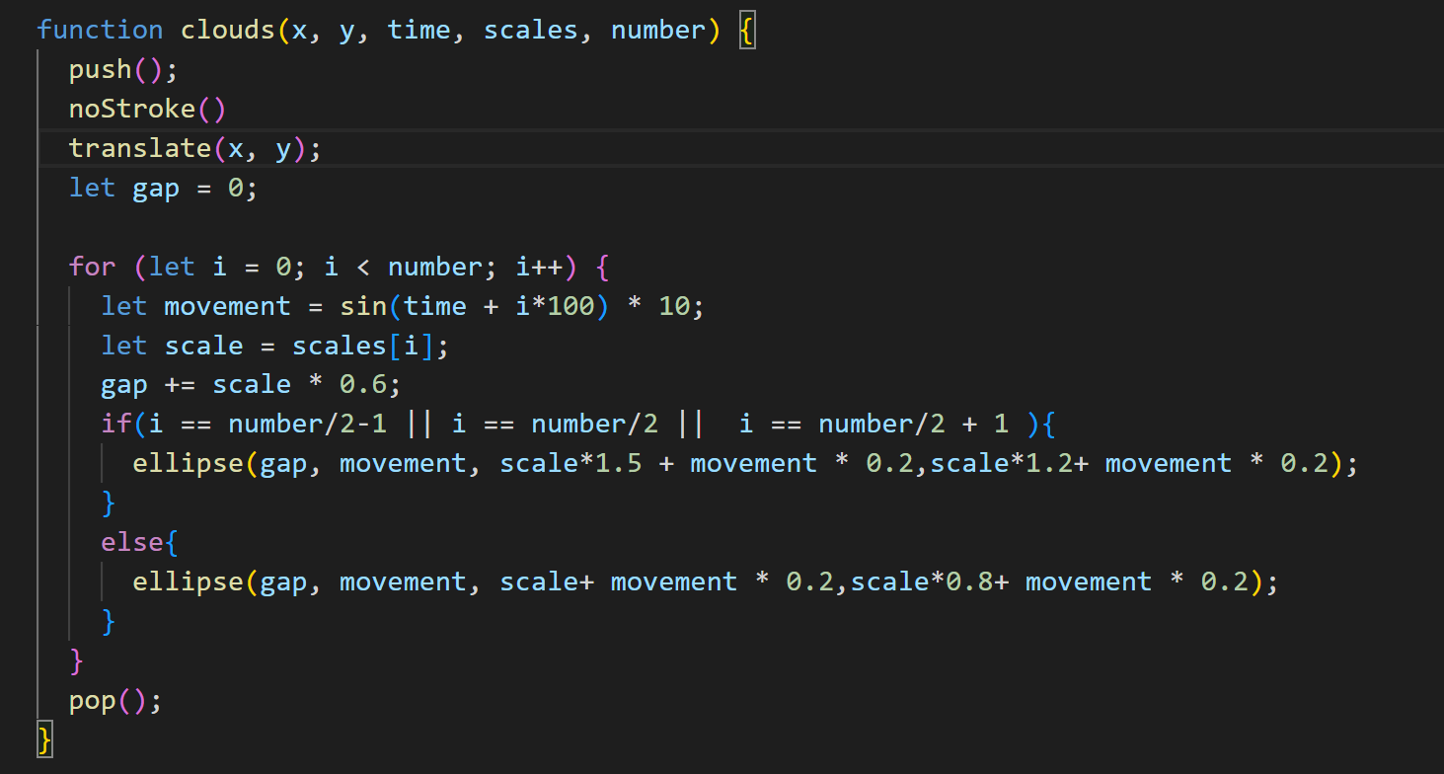
Highlights

Slide 8
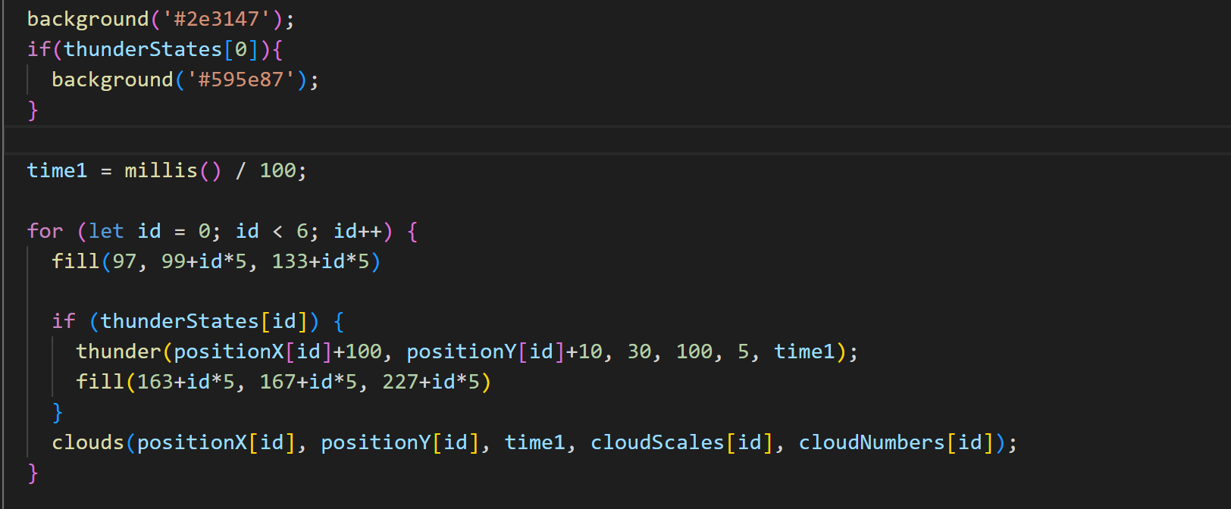
Highlights
https://github.com/shuyang-DM-GY-6063-2024Fall-B/MidTerm

Slide 9
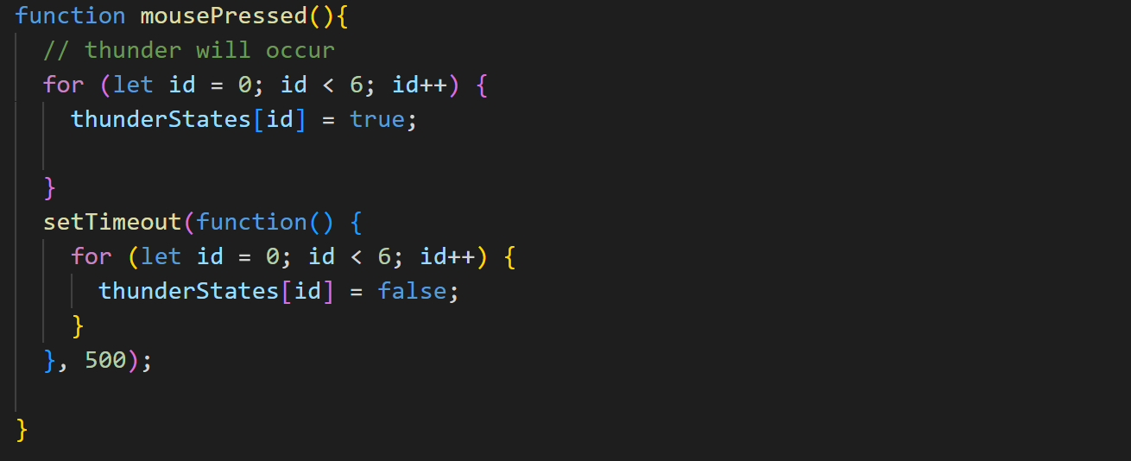
Highlights
https://github.com/shuyang-DM-GY-6063-2024Fall-B/MidTerm

Slide 10
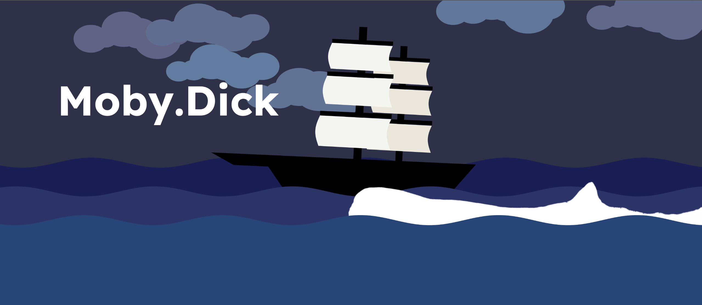
Demo
https://shuyang-dm-gy-6063-2024fall-b.github.io/MidTerm/

